Slide 1
Latent heat flux
Water flux
Evaporation rate, E (mm/day)
Energy flux
Latent heat flux (W/m²), H_{l}
ρ = 1000 kg/m³
l_{v} = 2.5 MJ/kg
28.94 W/m² = 1 mm/day
Temp | Lv | Density | Conversion
0 | 2501000 | 999.9 | 28.94
10 | 2477300 | 999.7 | 28.66
20 | 2453600 | 998.2 | 28.35
30 | 2429900 | 995.7 | 28.00
40 | 2406200 | 992.2 | 27.63
Area = 1 m²

Slide 2
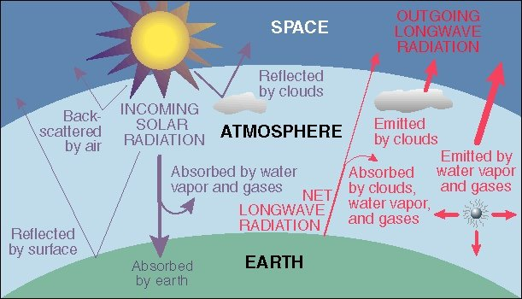
Energy Balance of Earth
20
70
100
6
6
26
4
38
15
19
21
Sensible heat flux 7
Latent heat flux 23
51
http://www.uwsp.edu/geo/faculty/ritter/geog101/textbook/energy/radiation_balance.html

